Slide 1

Bone Fracture Detection Using Convolutional Neural Networks (CNN) Model
Faculty of Engineering, Environment and Computing School of Computing, Electronics and Mathematics
7151CEM – Computing Individual Research Project
Student Name: Mohamed Imthiyas Abdul Razool
Student ID: 14357109
Supervisor Name: Dr Beate Grawemeyer

Slide 2
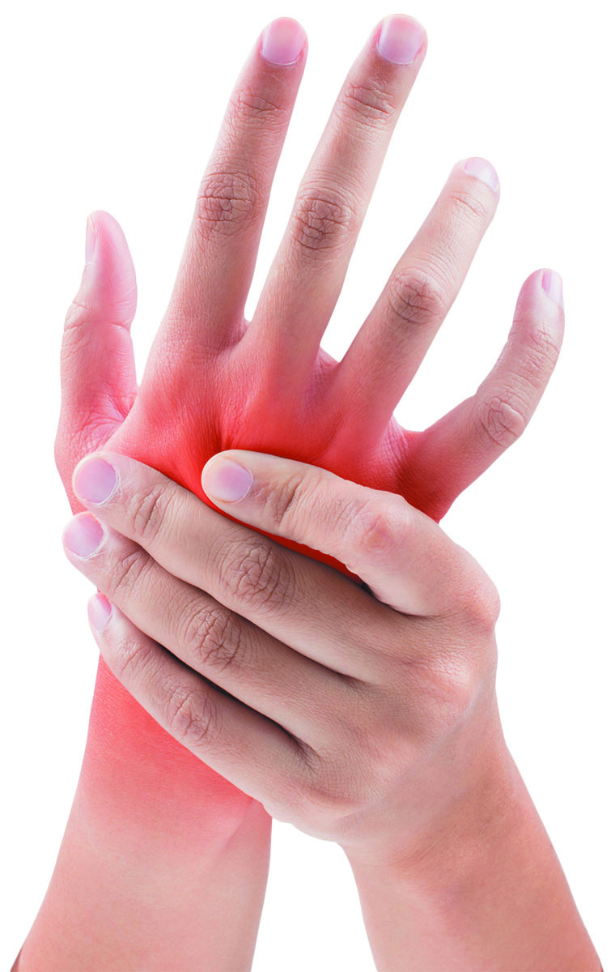
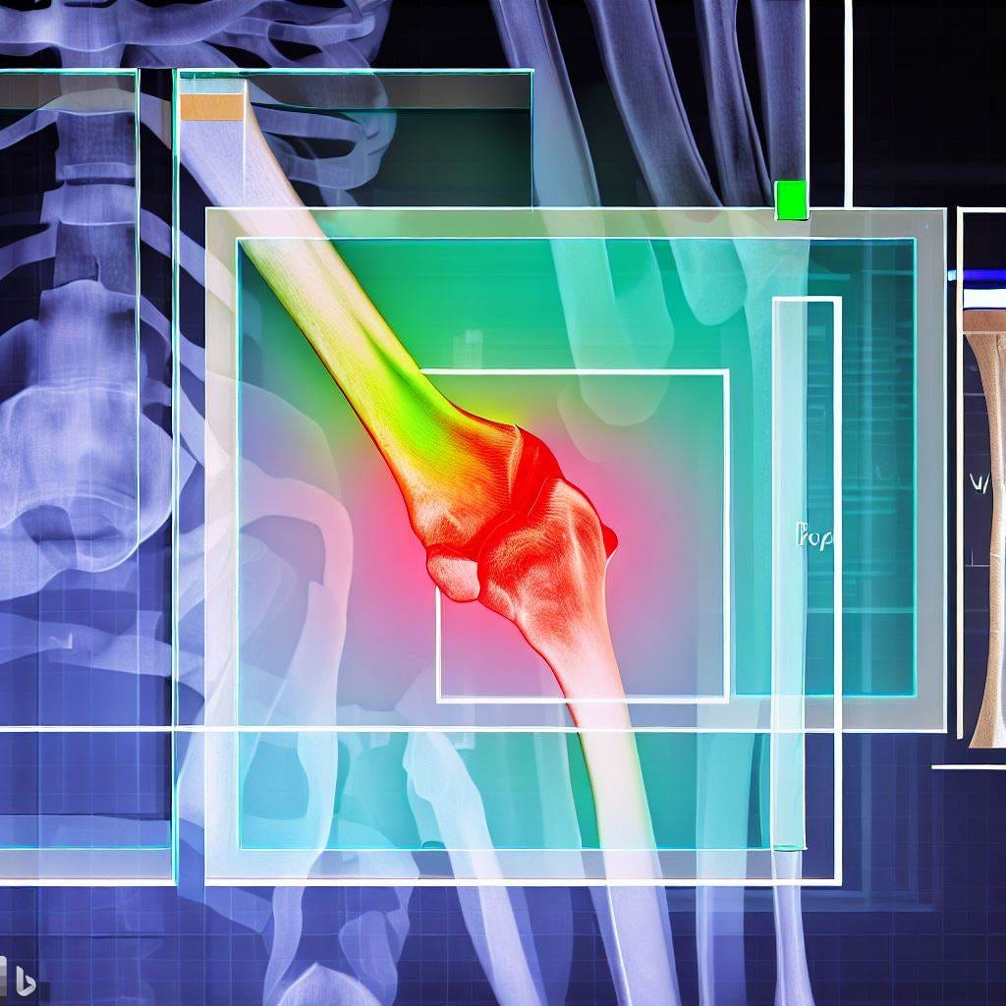
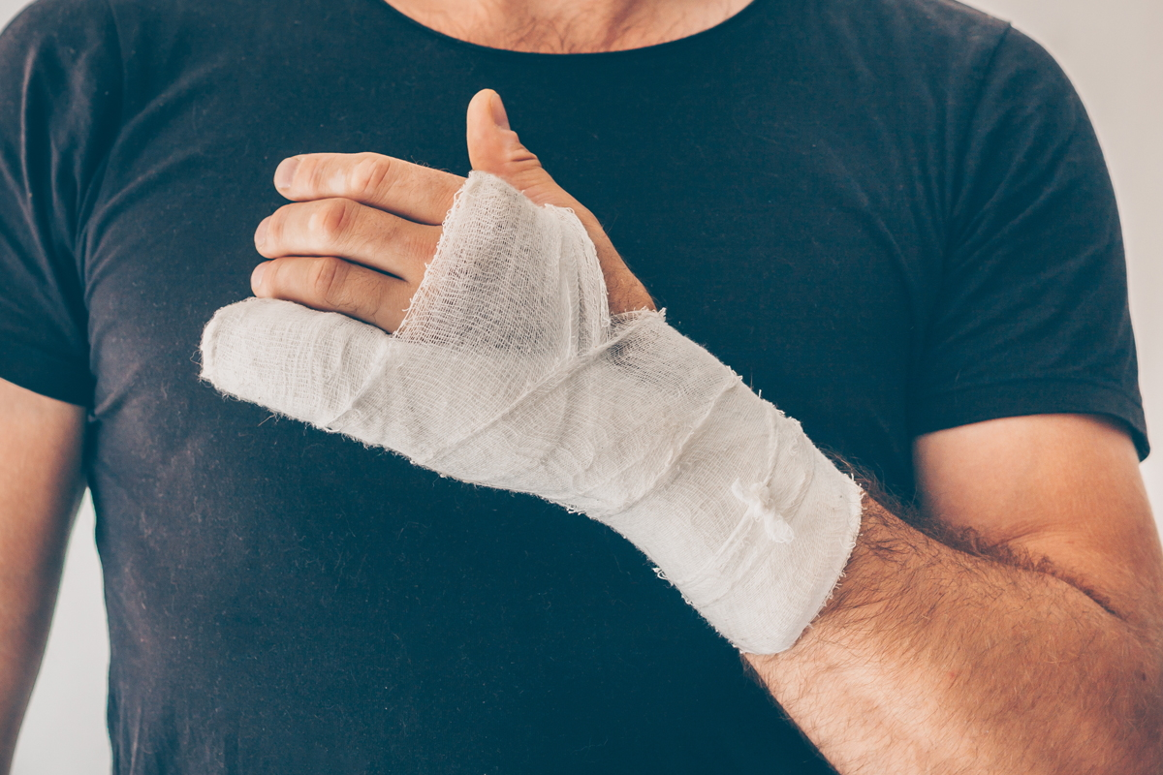

Slide 3
Table of Contents

Slide 4
Introduction
Bone fractures affect many people worldwide each year and need quick, accurate detection for proper treatment.
Traditionally, doctors look at X-rays to find fractures, but this can be slow and sometimes inaccurate.
This project aims to create and test CNN models to find the best one for detecting bone fractures in X-rays.
Using Convolutional Neural Networks (CNNs), a type of machine learning, can help automate and improve this process. CNNs are good at analyzing images and can identify fractures more accurately and faster than manual methods.

Slide 5
Related Studies (Literature Review)
Author | Modality | Model/Method | Description | Performance
Yu et al. (2020) | Radiographic images | Inception V3 | The proposed algorithm performed well in terms of APFF (Atypical Periprosthetic Femoral Fracture Associated) detection, but not so well in terms of fracture localization | Accuracy = 96.9 %
Majkowska et al. (2020) | Radiographic images | Xception | The authors developed a model to detect opacity, pneumothorax, mass or nodule, and fractures | Accuracy = 86 %
Wang et al. (2022) | CT | AlexNet and GoogLeNet | The author implemented a novel method for the classification and detection of mandibular fracture. | Accuracy = 90 %

Slide 6
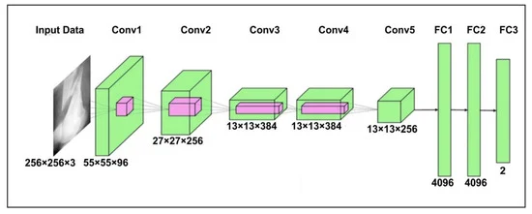
Why CNN?
As per the previous slide’s literature review, there are some models to develop this system such as
Inception V3
Xception
AlexNet
GoogLeNet
Also, those literature review helped to find out some GAPS as follows
Dataset (using selective bone parts images as a data)
Using single pre-trained model approach only
Accuracy was not impressive
To solve those Gaps, I choose CNN and my PROPOSED SOLUTION is “Using a CNN is the best approach for bone fracture detection in X-ray images. These models offer high accuracy, effective feature extraction, and scalability, making them a reliable tool for healthcare professionals to diagnose and treat bone fractures efficiently.”

Slide 7
Research Details
Research Question : How can a Convolutional Neural Network (CNN) be effectively designed and implemented to accurately detect bone fractures in medical images ?
And which CNN technique is the best for detecting bone fractures in X-ray images, and how reliable is it?
Research Aim: The aim of this research is to develop and validate a Convolutional Neural Network (CNN)-based model capable of accurately detecting bone fractures from medical imaging data using most appropriate CNN technique.
Objectives :
Data Acquisition and Preprocessing
Model Development
Training and Validation
Model Testing and Evaluation
Performance Comparison

Slide 8
Reasons for CNN sequential model
Aspect | Details
Technique | Convolutional Neural Network (CNN) using a Sequential model
Effective Feature Detection | CNNs automatically learn to recognize important features in images, such as edges and shapes, which helps in accurately identifying fractures.
Layer-by-Layer Design | Sequential models allow us to build the CNN step-by-step, making it easy to optimize the model for the best performance.
High Accuracy | CNNs have shown to be very accurate in image classification tasks, often outperforming traditional methods and even human experts.
Scalability | These models can handle large datasets, which is crucial for medical applications that require extensive training data.
Less Manual Work | CNNs do not need manual feature extraction, simplifying the model development process.

Slide 9
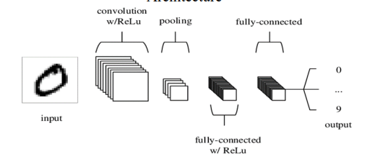
Reliability of CNN sequential Models
Data-Driven Performance | The reliability of CNNs improves with more and better-quality training data, allowing them to detect a wide range of fracture patterns.
Proven Success | CNNs are widely used in medical imaging, successfully detecting various conditions, including bone fractures.
Continuous Learning | CNN models can be updated with new data, keeping them current with the latest medical findings.

Slide 10
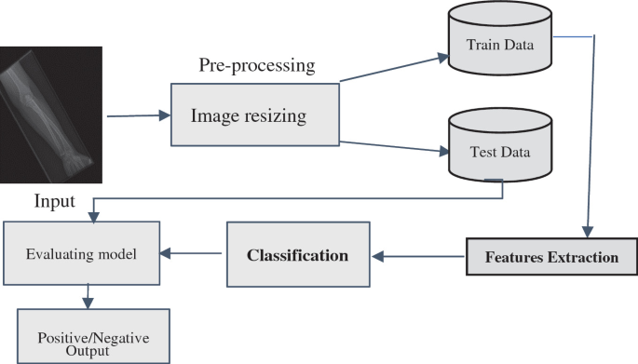
Process Flow

Slide 11
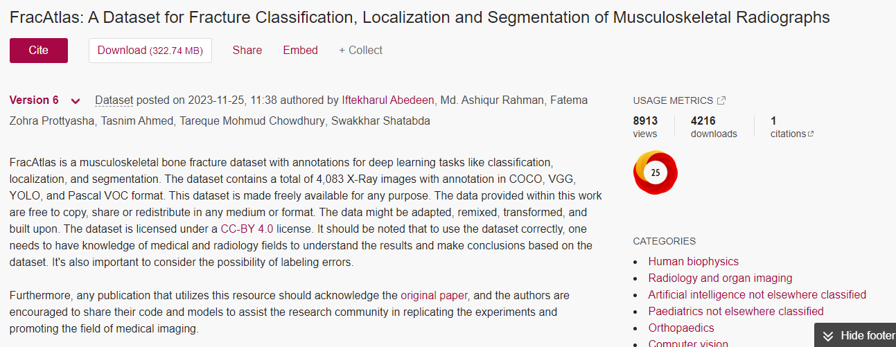

Dataset

Slide 12
Setup
Notebook : Google Collaboratory
Programming Language : Python
Storage Space : Google Drive (Dataset and Model Storage)
Implementation Stages : 1. Importing Libraries
2. Data Reading
3. Transformation
4. Data Splitting and Loading
5. Create Model Base
6. Training the Model
7. Model Evaluation
8. Real Time Checking

Slide 13
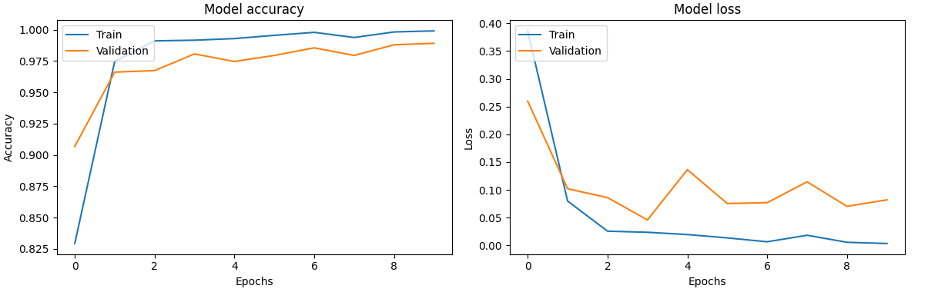
Results
val_accuracy: 0.9891
loss: 0.0036

Slide 14
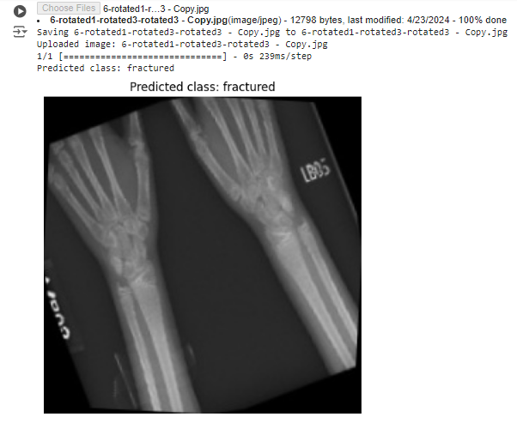
Output

Slide 15

Discussion
To answer the research question, we propose using a Sequential model for the CNN. This model will be built layer by layer, allowing for flexibility and optimization in detecting bone fractures. The Sequential model approach simplifies the design process and ensures that each layer contributes effectively to the overall performance of the network. By following the objectives, we aim to develop a highly accurate and reliable model for bone fracture detection in medical images.

Slide 16
Conclusion
In conclusion, this project on bone fracture detection using Convolutional Neural Networks (CNN) has been a valuable and insightful experience. Key learnings from the project include:
Technical Skills:
Developing and implementing CNN models improved my understanding of deep learning and image recognition.
Data Handling and Preprocessing:
Effective data preprocessing, including standardizing image sizes, normalizing pixel values, and data augmentation, was essential for preparing the dataset and ensuring model accuracy.
Model Development and Optimization:
Building and fine-tuning a Sequential CNN model demonstrated the importance of iterative testing and hyperparameter optimization.
Interdisciplinary Perspectives:
Combining knowledge from machine learning and medical imaging provided a well-rounded approach to solving the problem.
Ethical Considerations:
Addressing privacy and ethical issues related to medical data highlighted the importance of responsible AI development.
This project has significantly contributed to my personal and professional growth, deepening my understanding of machine learning and its practical applications in healthcare. It showcases the potential of advanced algorithms in improving medical diagnosis and treatment.

Slide 17
Thank you

